Slide 1

Employee Attrition

Slide 2
Introduction
XYZ company which was established a few years back is facing around a 15% attrition rate for a couple of years. And it's majorly affecting the company in many aspects.
So, here we’ve tried to find the reasons and the conclusions for this attrition.

Slide 3
Main KPIs
Total Employees – Total number of employees in company
Attrition Count – Number of employees attrition
Attrition Rate – Percentage of employees retention
Average age – Overall Average age of all the employees
Avg monthly income – Average income for all the employees
Avg years at company – Average number of years the employees is working with the company

Slide 4
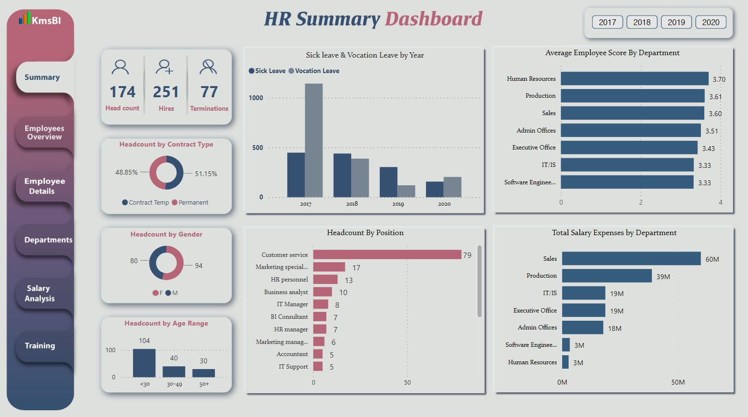
Mock – up Dashboard

Slide 5
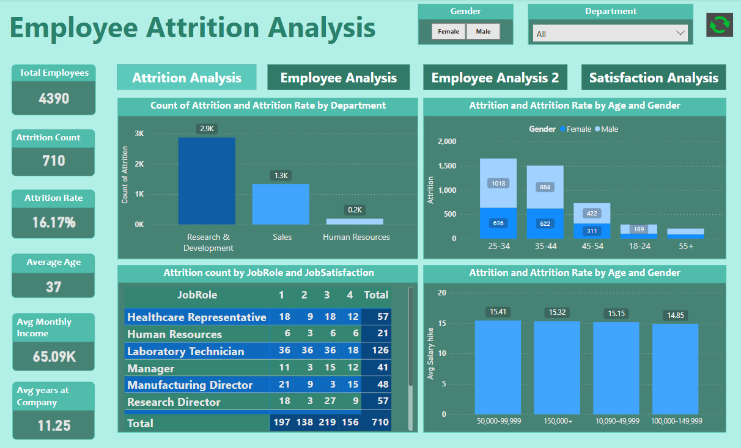
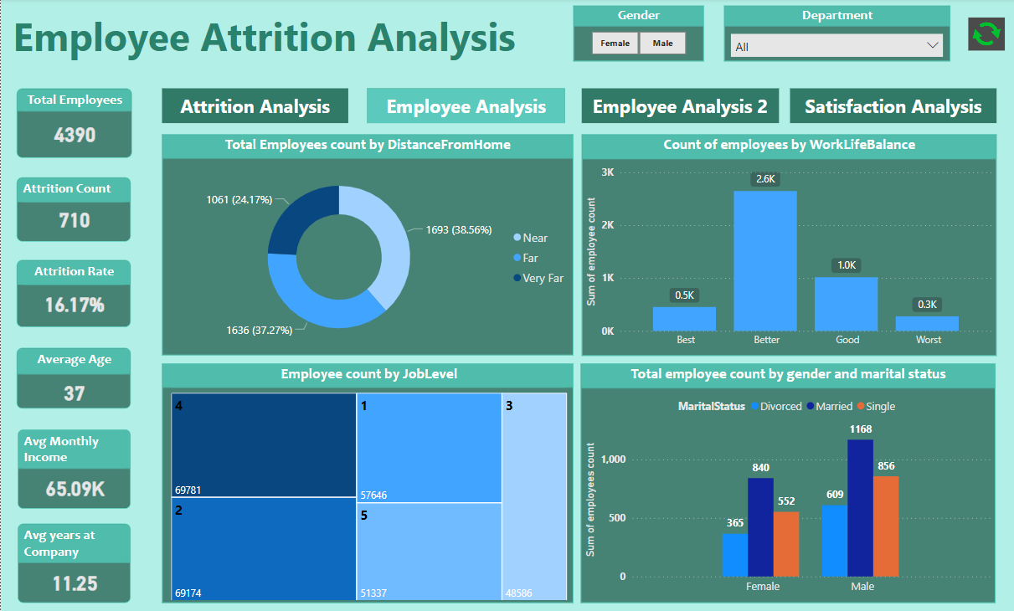
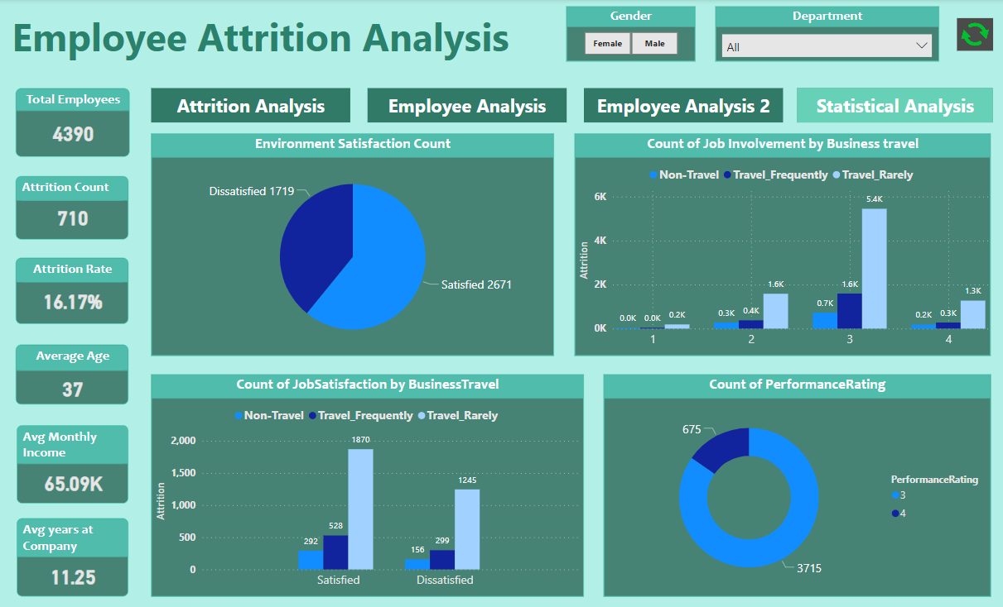
My Design

Slide 6
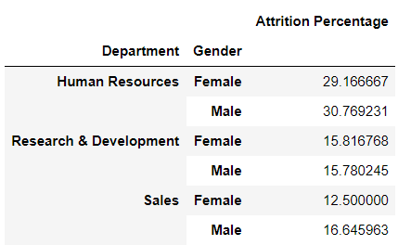
There are more attritions of male than female in almost each departments.

Slide 7
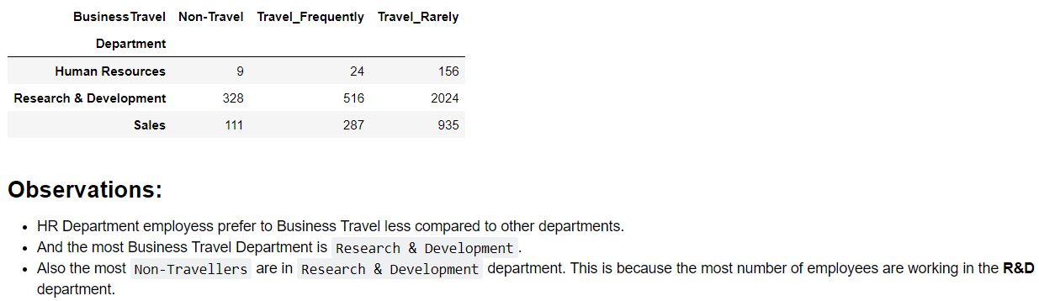
Department group-by Business Travel

Slide 8
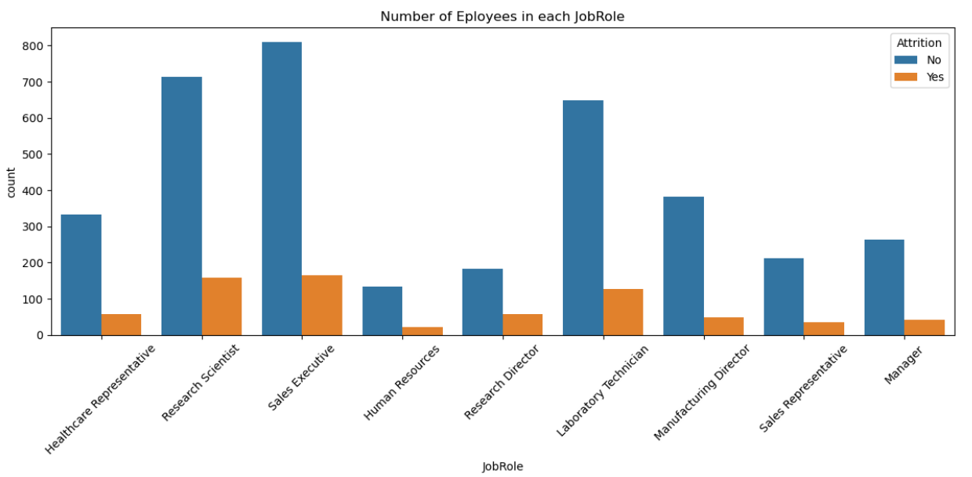
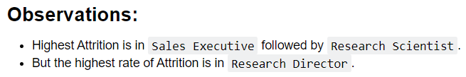

Slide 9
Thank you

